Slide 1





WHATEVER YOU CAN CONCEIVE AND BELIEVE…WE HELP YOU ACHIEVE IT.

Slide 2
We are basically headquartered in Fremont and Newark, California
As Recruitment Process Outsourcing (RPO):We are dedicated to provide IT services. using latest technologies & trends. We offer our Staff Augmentation, IT consulting & Software development services to all our clients at most of the overseas locations with our highly skilled consultants having vast experience in their relevant fields. We provide contract Services that are a right solution for the companies which find frequent fluctuations in their need for technical resources & have short term requirements for their IT needs.

Slide 3
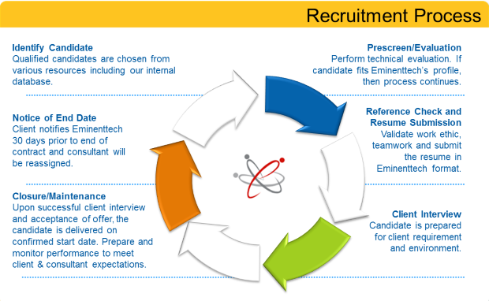

Slide 4
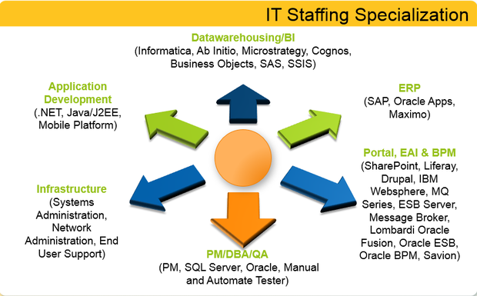

AREA OF SPECILIZATION

Slide 5

COMPANY VISION
MANAGEMENT
COMMUNICATION SKILLS
PRESENTATION TRAINING
PROJECT MANAGEMENT TRAINING
SALES TRAINING
QUALITY ASSURANCE
RECRUITMENT TRAINING
TEAM BUILDING TRAINING
TIME MANAGEMENT TRAINING

Slide 6

Our TEAM provides services in following industry sectors-
Engineering & Manufacturing
Automotive
Oil, Gas and Power
Steel
FMCG
Consumer Durables
IT & ITES
Telecom
Pharmaceutical
Media & Entertainment
Retail
Banking
Insurance
Hotel, Hospital
Education
Real Estate, Infrastructure, Construction

Slide 7
OUR KEY DIFFERENTIATORS
We visualize, plan and create solutions before we deploy them for you.
We provides personalized services to its clients and maintains confidentiality on need basis.
We adept in formulating and aligning organization’s people, strategy and operations with a focus on value maximization.

Slide 8
Difference Between BPO and RPO
Business Process Outsourcing (BPO): All Business Domains & Functions
– Document processing/ Basic Knowledge
– Data entry, Data analytics – Data/market/IP research
– Customer Service, Customer Support, Helpdesk
– Billing, verifications
– Transcriptions
– Outbound/Inbound Calling, Market /Competitor research
Recruitment Process Outsourcing (RPO):
Human Resources
– RPO is a partnership between a company with recruiting needs (RPO buyer) and a company with recruiting services (RPO provider) in which the RPO buyer's brand is being promoted instead of the provider's.
– Stream Specific Knowledge/ Need Specialties
– Monitoring & Managing with Client in US needs etc.
– Its not the Help Desk or Customer Service

Slide 9
WORKING PROCEDURE
In India we are in NCR region with four offices.
Timings are ( US timings ) – From 8:00 PM to 5:30 AM
Attractive Bonus ( Every 6 Months Salary Revision + Monthly Incentives ) – We have the best Salary Policy In industry
No Target Pressure
Friendly Environment

Slide 10
OUR VALUES
COMMITMENT
LOYALTY
TEAM SPIRIT
INTEGRITY
PEOPLE FOCUS

Slide 11
There is one quality that one must possess to win,
and that is definiteness of purpose,
the knowledge of what one wants and
the burning desire to achieve it.
-- Napoleon Hill
THANK YOU

